Slide 1



A different kind of homework…

Slide 2
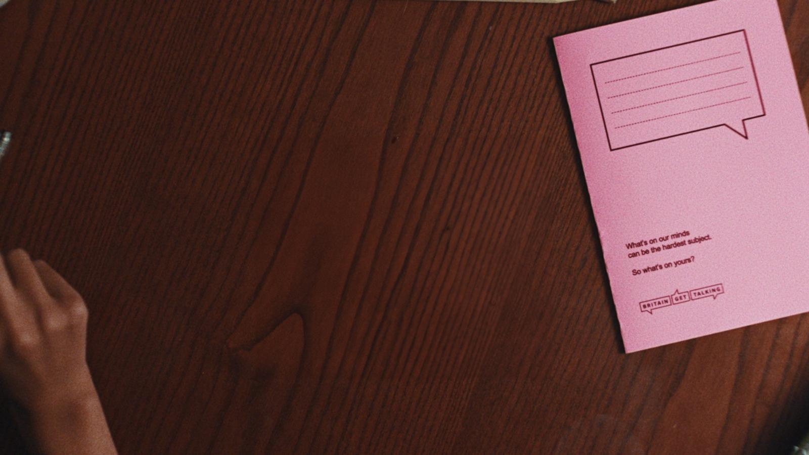

What do we mean by “mental health”?

Slide 3


We all know how to take care of our body. We eat well, keep active and get plenty of sleep, but what about our minds?
Mental health is about how we think and feel about ourselves, the world around us, and other people.
It’s to do with how we manage really big feelings, how we get on with each other, how we make choices, how we handle stress and what we do. It’s linked to physical health too.
One thing that can help is knowing how to share our worries.
This can help us to handle life’s ups and downs.

Slide 4

Big Feelings
Small Feelings
Everyday we experience different feelings that come and go. It’s normal to feel different feelings. No one feels happy all the time.
Some feelings are so big and powerful that they get in the way of our everyday life and can last for ages. These can affect our mental health. They can feel hard to talk about too.
Happiness
Sadness
Feeling grumpy
Depression
Anxiety
Fear
Content adapted from: Anna Freud Centre

Slide 5


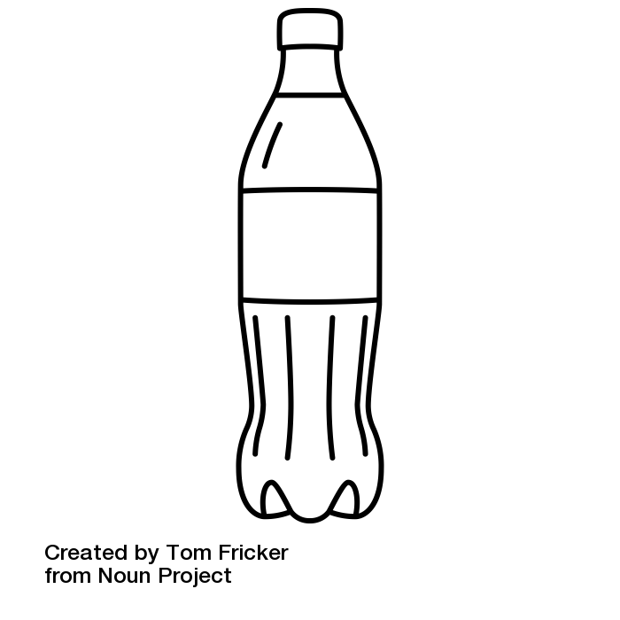
Imagine your mind is a bottle of fizzy drink
When you shake up a bottle of fizzy drink, pressure builds up.
If we don’t release the cap to let some pressure out, it might explode.
Sometimes if we feel very stressed it can feel like pressure is building up for us too.
Finding ways to release the pressure and reduce our stress is important.
These ways are different for everyone, but one thing that often helps is talking to someone else about your worries.

Slide 6
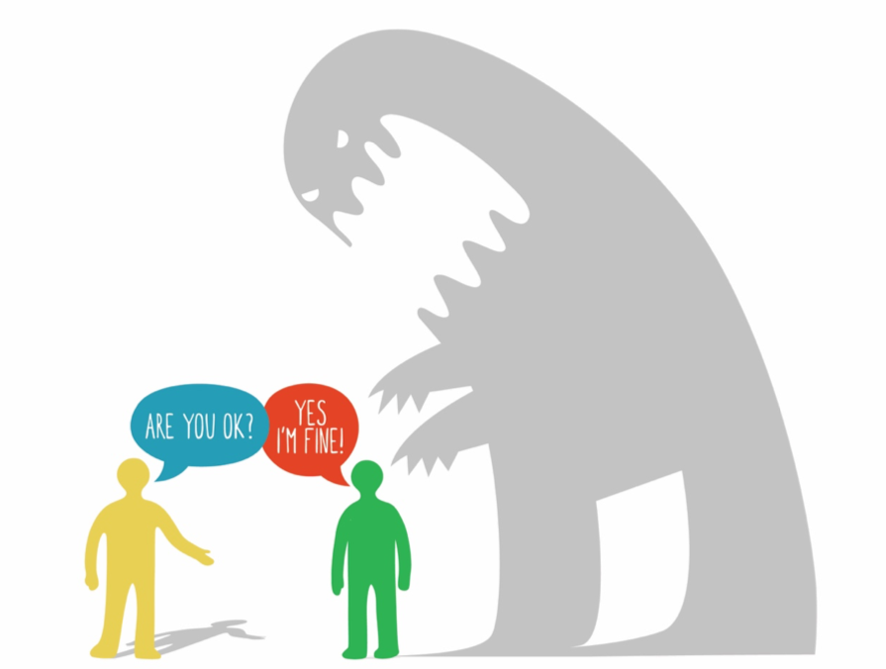
Talking about our worries isn’t always easy.
We know that lots of young people have worries.
We know that it’s common for young people not to want to worry the adults around them by talking about what is stressing them out.
You might say “I’m fine” but
not really mean it.
Image from What is Mental Health? By Dr Lucy Maddox

Slide 7
Why talking matters

Slide 8




Why talking matters
It’s normal to worry about telling someone how you feel
but trying to deal with things on your own can make things feel worse.
Talking about worries can help them to feel smaller.
It can make you feel less alone.
It might even help you find a solution.

Slide 9
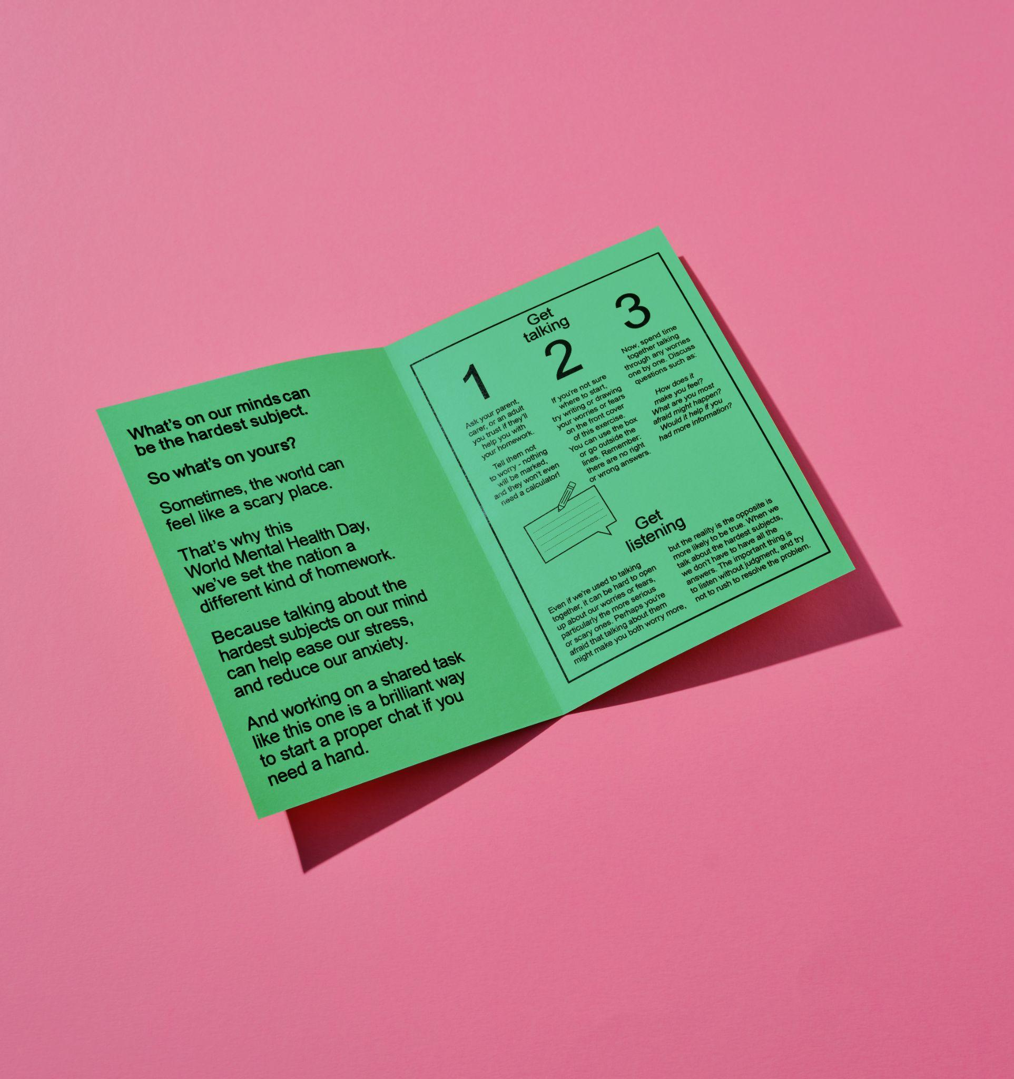
That’s why STV’s
Britain Get talking is setting you and an adult you trust a very special task…

Slide 10

Ant & Dec Assembly video available here

Slide 11

A different kind
of homework.

Slide 12
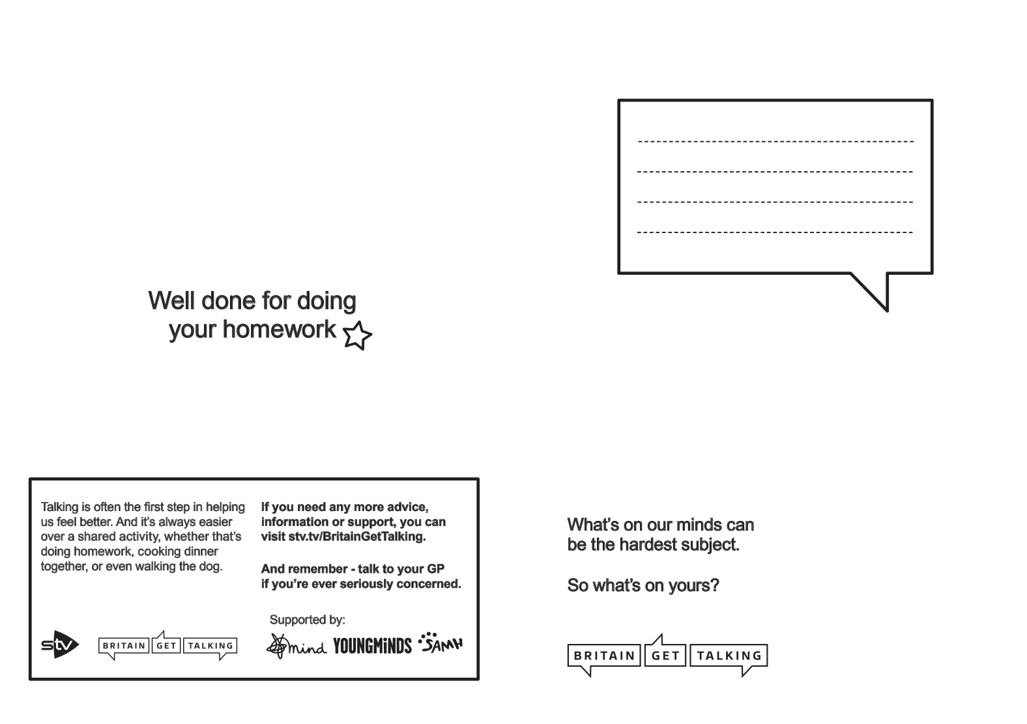
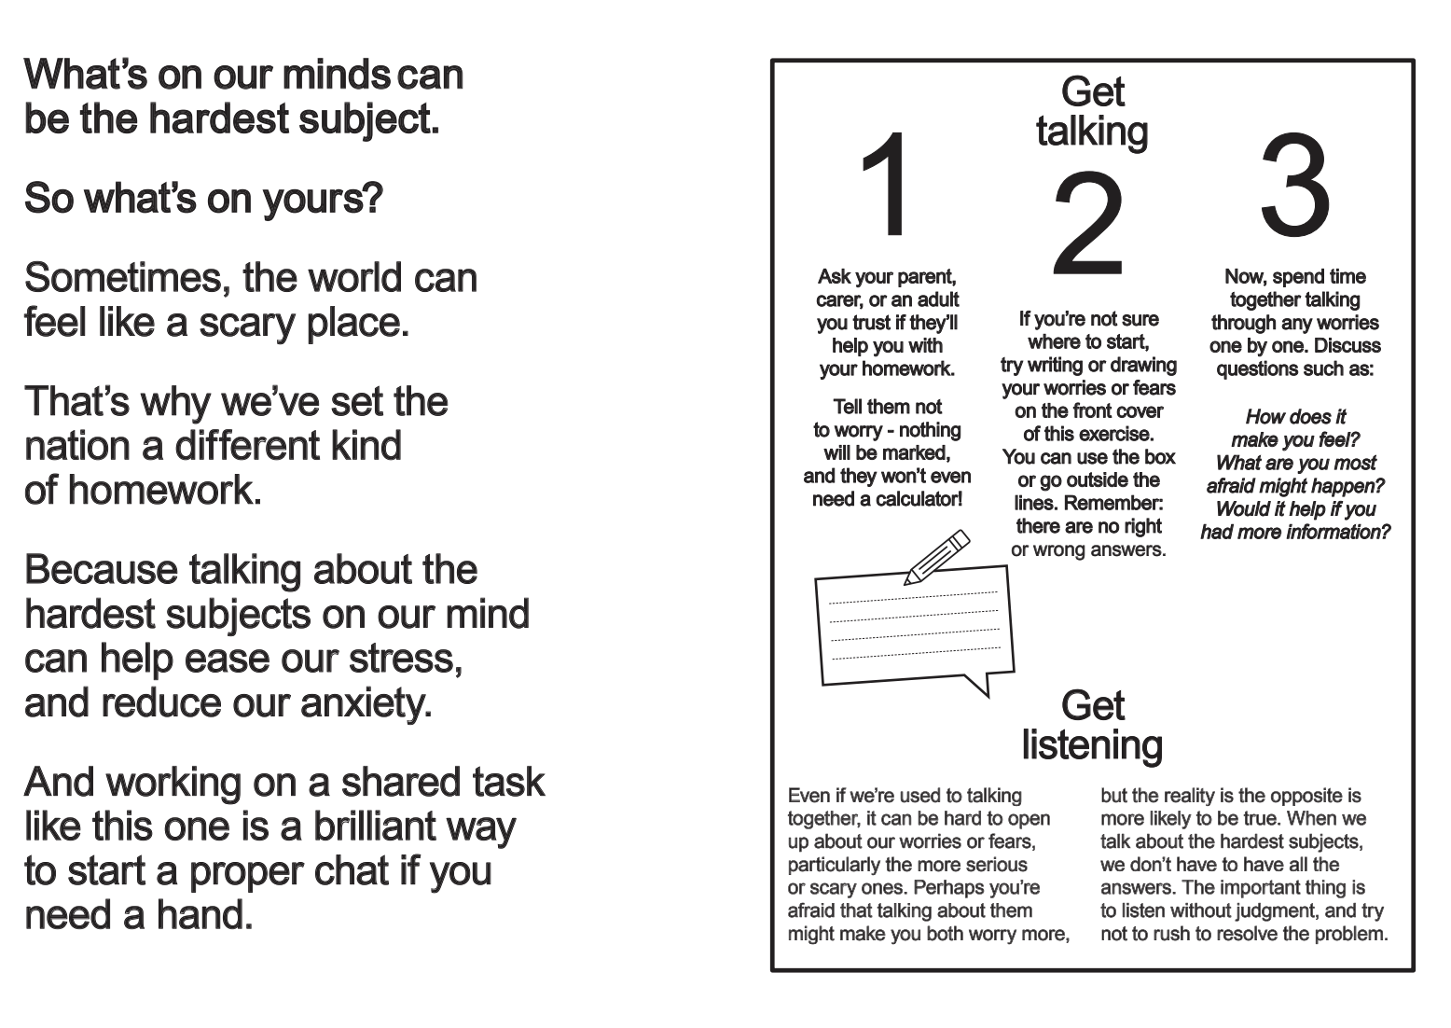

Slide 13
Reflective Task - Primary School
Think of a time when you did share something
you were worried about with someone else.
What happened?
What was good?
If you are going to share another worry
would anything help it to go better?

Slide 14
Reflective task - Examples
Here are two examples of ways that young people have tried to help a chat about worries go well.
Esme is worried about the move to secondary school
She wants to talk to her mum but she usually just says “Don’t worry.”
Before she talks to her she says “Please listen to everything I want to say before you say anything.”
Davis wants to talk to his older brother about a worry concerning a row with his friends.
Last time he tried to talk his brother teased him.
This time he says “Can I talk to you about something I’m really scared about” so his brother knows it’s important.

Slide 15
Reflective Task - Secondary School
Think of a time when you did share something you were worried about with someone else.
How did it go?
What went well?
Is there anything you would do differently next time?
If you talk to a parent or carer about a current worry, is there anything you would like to say to them about how they respond?

Slide 16
Reflective Task Examples
Here are two examples of ways that young people have tried to help a chat about worries go well.
Otis is worried about his exams
He wants to talk to his mum but she usually just says “don’t worry”
Before he talks to her he says “please listen to everything I want to say and don’t try to jump in and reassure me.”
Carrie is worried about some trouble she has got into on social media.
She wants to talk to someone but she thinks her parents will be disappointed and angry.
She decides to write it down to give to them and at the start she writes “please don’t be cross or judge me. I am already feeling really bad.”

Slide 17


Where to get help
However you’re feeling, you’re not alone.
Remember to talk to someone you trust if you’re struggling.
For practical tips on looking after yourself, as well as information on how to find help, visit www.YoungMinds.org.uk or www.SAMH.org.uk

